Slide 1
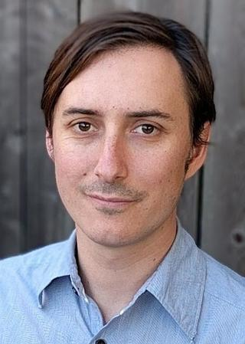
The Biology Department at Niagara University presents
“Don’t shoot the messenger: CRISPR strategies to study RNA Biology”
Dr. Mitch O’Connell, Assistant Professor in the Department of Biochemistry and Physics at the University of Rochester will be discussing his research on mechanisms of RNA-mediated gene regulation using RNA-targeting CRISPR strategies.
Friday May 3rd
12:20pm-1:15pm
Golisano 101
For questions or persons in need of accommodations, please contact Connie Guthrie Greene at cag@niagara.edu

